Slide 1
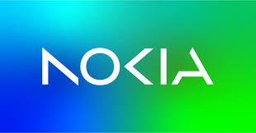
Automation of the Cloud
Farkas Andrei
Ples Serban
Dinescu Denisa
Responsible: Valentin Sorescu valentin.sorescu@nokia.com
Iasmin Tomici iasmin.tomici@nokia.com

Slide 2

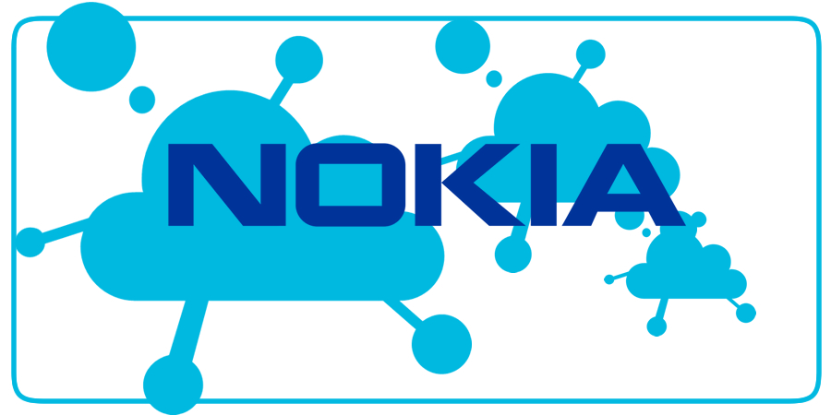
Project Description
The "Automation of the Cloud" project is designed to streamline the management of virtual machines (VMs) and automatize a time costly and repetitive task. This project is a solution for the daily tasks in nokia testers lives, providing a user-friendly interface that simplifies interactions. The primary goal is to deliver a platform that not only facilitates VM operations but also secures access and automates various administrative tasks.

Slide 3
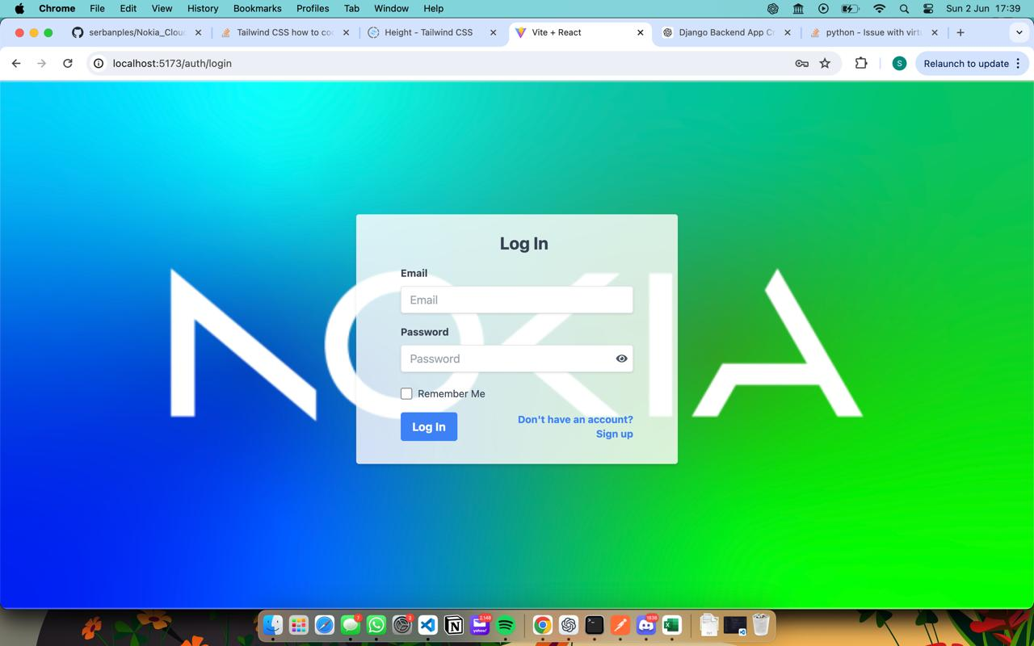
Project Overview
Purpose:
The project focuses on managing virtual machines (VMs) and controlling user access within a cloud environment.
Objectives:
To simplify VM management and enhance security by providing a user-friendly interface for VM interactions and access controls.
Key Features:
User Authentication: Secure login and signup functionality.
Dashboard: Overview of available VMs and their status.
VM Management: Create, update, delete, and connect to VMs.
Access Control: Assign and revoke user access to specific VMs.
Technologies Used:
Built using Flask for the backend, React for the frontend, and JWT Authentication for authentication.

Slide 4
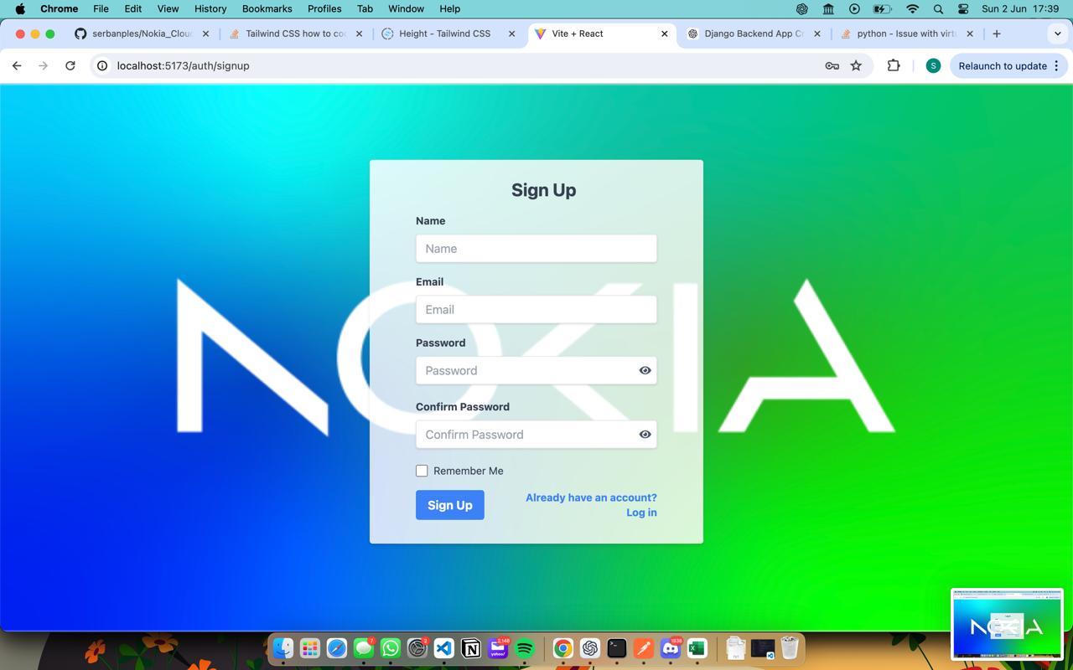
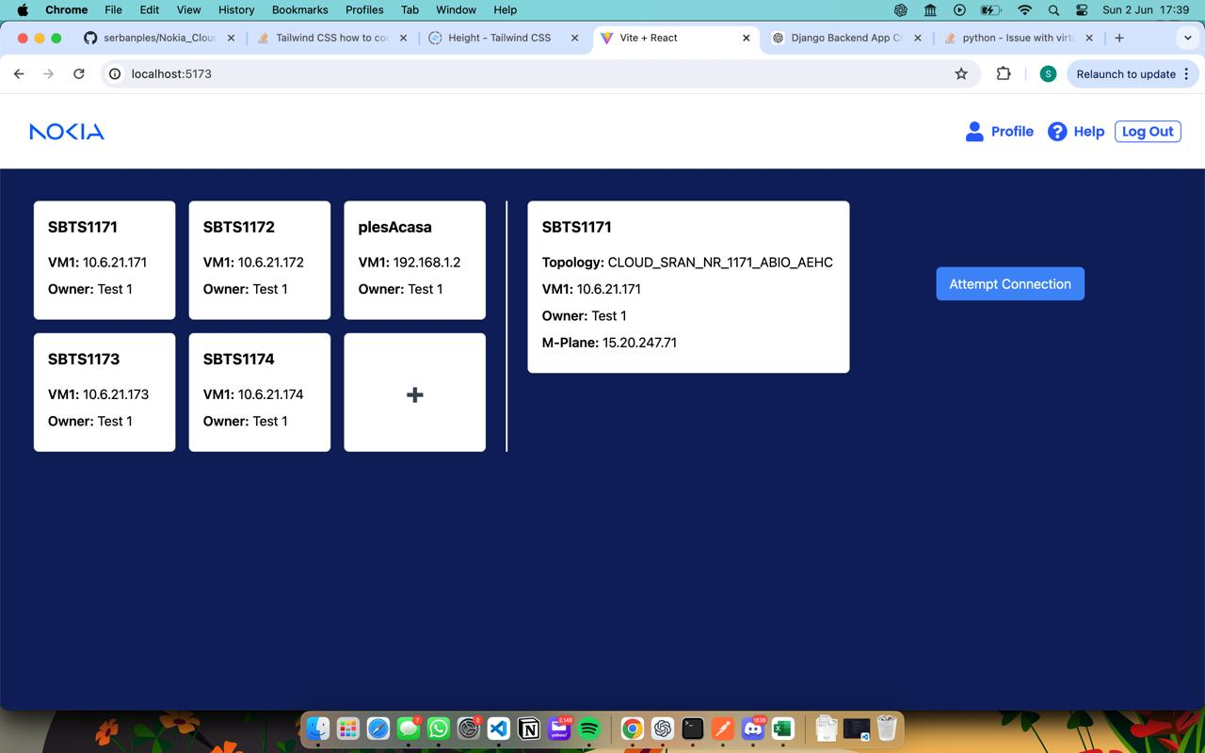
Key Features
1. User Authentication:
Secure login and signup functionality.
Utilizes JWT for secure authentication.
Ensures only authorized users can access the system.
2. Dashboard:
Provides an overview of all available VMs and their statuses.
Allows users to quickly see the available VMs and easily access them.

Slide 5
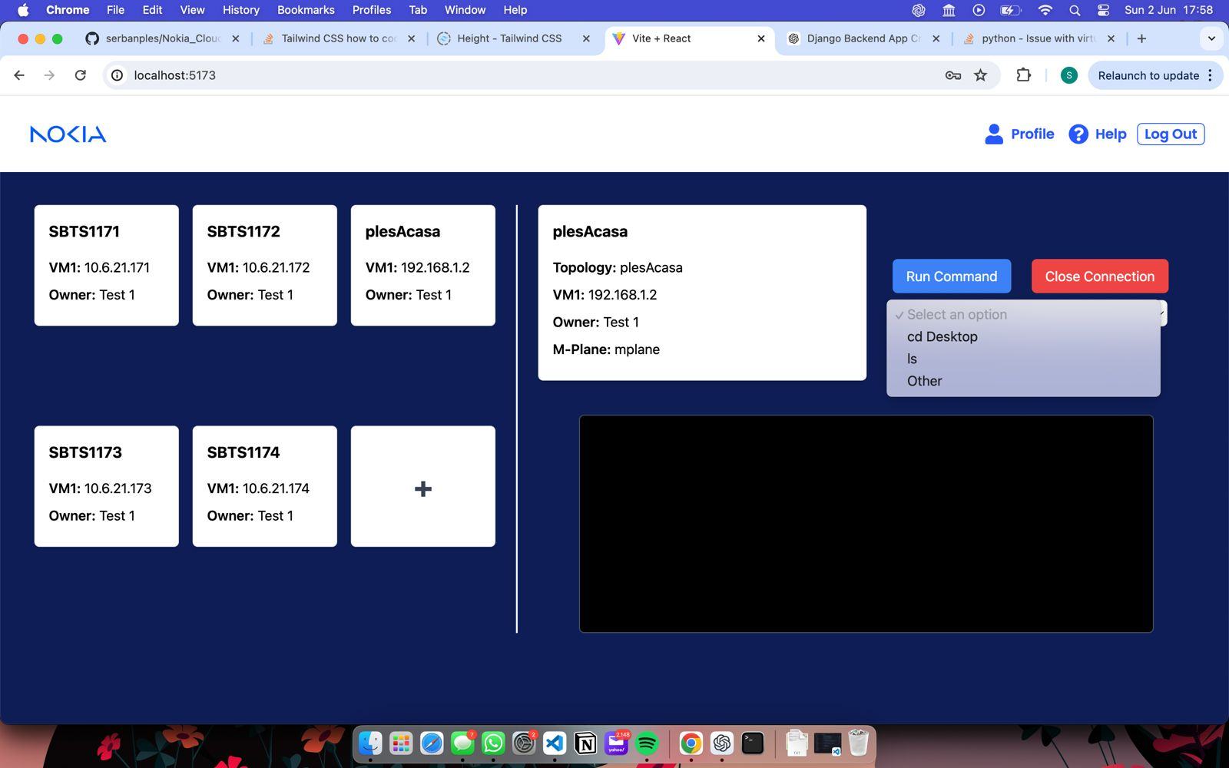
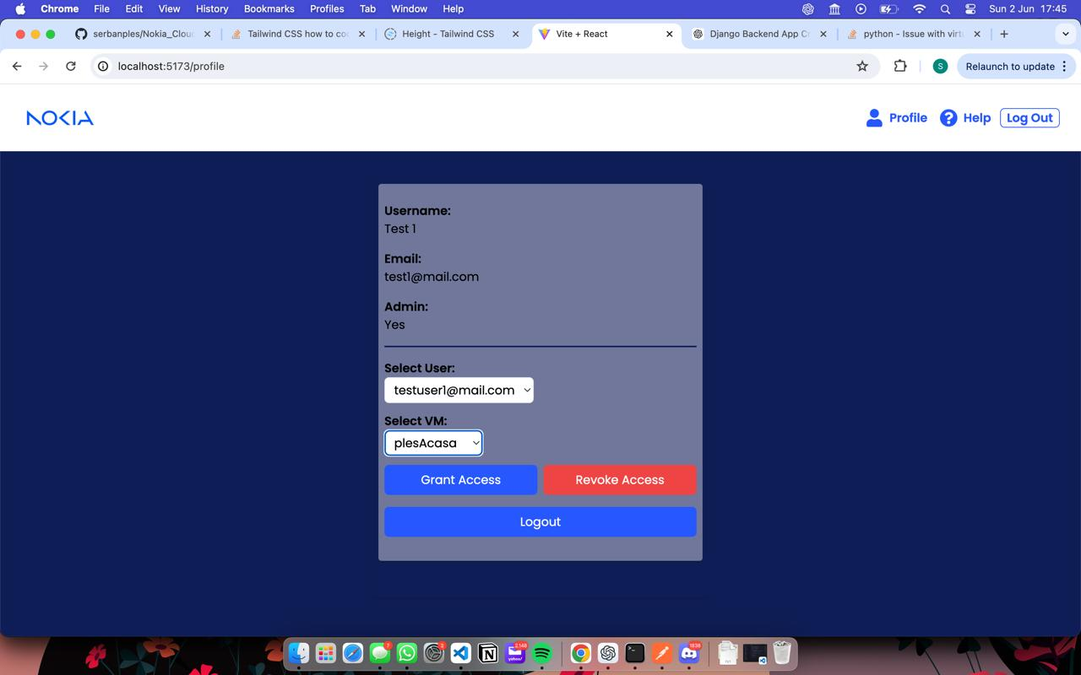
Key Features
3. VM Management:
Admins can create, update, delete, and connect to VMs.
Simplifies the management of VMs through a user-friendly interface.
Provides detailed information about each VM, such as IP addresses, name, and owner.
. Access Control:
Admins can assign and revoke user access to specific VMs.
Role-based access control to ensure security and proper access management.
Detailed logs of access requests and permissions changes.

Slide 6

The Most challenging parts
1. Authentication and Authorization:
Challenge:
Implementing a secure and efficient authentication mechanism.
Ensuring proper role-based access control for different user types.
Solution:
Integrated JWT for secure login and signup processes.
Developed a role-based access control system to manage permissions effectively.
2. User Interface Design:
Challenge:
Creating a user-friendly interface that caters to both novice and experienced users.
Balancing functionality with simplicity in design.
Solution:
Conducted user testing to gather feedback and iterate on the design.
Employed a modular design approach to ensure scalability and ease of use.

Slide 7

How things work
1. User Authentication and Authorization:
Process:
Users sign up or log in using JWT.
The system validates user credentials and assigns appropriate roles.
Users gain access to the platform based on their roles and permissions.
2. VM Management:
Process:
Users interact with the dashboard to create, update, delete, or connect to VMs.
The backend processes these requests and updates the VM statuses accordingly.
Real-time updates ensure users see the latest VM status without refreshing the page.

